Slide 1
5CS024 – 7CC002 Sprint 1 Kick-off

Slide 2
Sprint 1 Kick-off
“This module aims to integrate the subject material studied in other level 4 and 5 modules and give students experience of developing a software or hardware artefact in a team. Students will learn to work in teams to coordinate and manage a project.”

Slide 3
Sprint 1 Kick-off
LO1 Communicate effectively with others to jointly complete tasks with peers or with staff in an organisation.
LO2 Demonstrate an ability to meet deadlines and objectives

Slide 4
Programme
Week 4 (Sprint 1)
Project Kick-off Sprint 1- MVP
Introduce the development process

Slide 5
Programme
Week 8
Submit (MVP)
Code repository
Demonstration Video
Individual Contribution reports
General part
Role specific part

Slide 6
Programme (4 Weeks)
Working prototype?
4
8

Slide 7
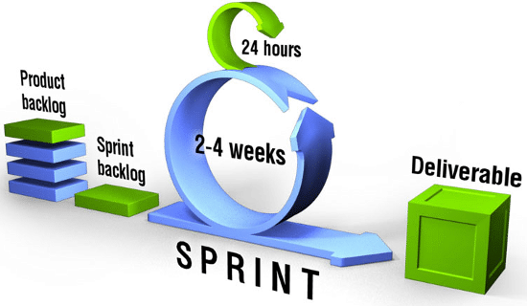
Scrum

Slide 8
Progress tracking
Each week
Track progress
Identify any updated issues, solutions or priorities
Agree new tasks
Keep in the loop while working

Slide 9
Submissions
Each week of the sprint Project manager submits a status report for the group.
Status
Ahead of schedule
On track
Behind schedule
Distressed

Slide 10
Sprint 1
MVP Artifact Repository (15%)
MVP Demonstration Video (15%)
MVP Individual Contribution Report (20%)
In cases where contributions are disputed additional evidence may be submitted.

Slide 11
MVP Artifact Repository
Your group should provide access to the source files you have used of created in the implementation of the system demonstrated in the video. This includes code, config files, graphics and any other relevant documents NB: This should be via a URL link and not a compressed file or zip of the source code. Where appropriate you should use appropriate source control mechanisms to collaborate.

Slide 12
MVP Demonstration Video
Your group should create a video to demonstrate the features of the MVP working prototype you have created. Each member should talk about their contribution to the work in the repository. This should include some discussion of the groups vision of what they would like the finished system to be (Essentially a pitch for early investors). Your video should be between 5 and 10 minutes long and all group members should take part.

Slide 13
Individual Contribution Report
Describe your main contribution to the project including meetings, work in the repository and features demonstrated in the video:
What new skills have you learned while working on this group project and how might they be useful in the future?:
Discuss any new ideas or knowledge you have gained through team interacting with other members of the team:

Slide 14
Individual Contribution Report
What were the biggest challenges you faced as an individual and as a team and how did you handle them?:
Describe the significant contributions you made in your role(s), particularly technical or strategic decisions

Slide 15
Project Manager
Responsible for
Co-ordinating development
Planning scope
Submitting joint work
Managing deadlines
Communicating with staff
Evidence includes
Meeting invites
Meeting outcomes
Plans, emails
Kanban chart, funnel

Slide 16
Business Analyst
Responsible for
Understanding and communicating business value
Identifying requirements
Prioritising work delivery
Evidence includes
Context diagram, innovation funnel
Notes, emails, design diagrams

Slide 17
Database Analyst
Responsible for
Understanding data requirements
Design decisions on data aspects of the project
Database design and implementation
Evidence includes
Data model
Test cases
Notes, emails, design diagrams

Slide 18
Security Analyst
Responsible for
Understanding security, risk and privacy requirements
Design decisions on security needs of the project
Support security implementation
Evidence includes
Threat model
Risk table
Security test cases
Notes, emails, design diagrams

Slide 19
Software Developer
Responsible for
Design decisions on software development needs of the project
Choosing languages, tools, frameworks etc
Implementation build and testing
Evidence includes
Code
Testing
Notes, emails, design diagrams

Slide 20
Embedded Developer
Responsible for
Design decisions on embedded development needs of the project
Choosing devices, platforms, protocols etc
Implementation build and testing
Evidence includes
Code
Testing
Notes, emails, design diagrams

Slide 21
Questions

